Slide 1
PSDA I: AVL Tree
Balanced Binary Search Tree
Adelson-Velskii dan Landis

Slide 2
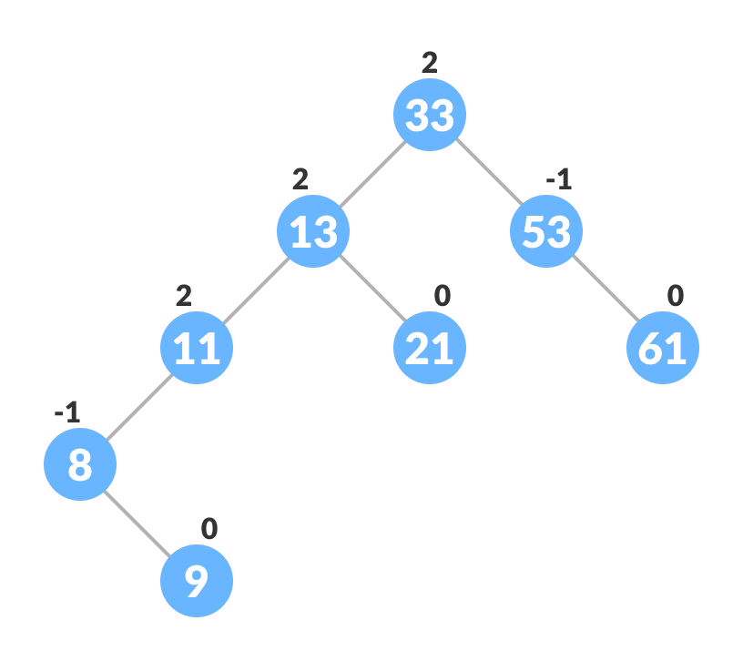
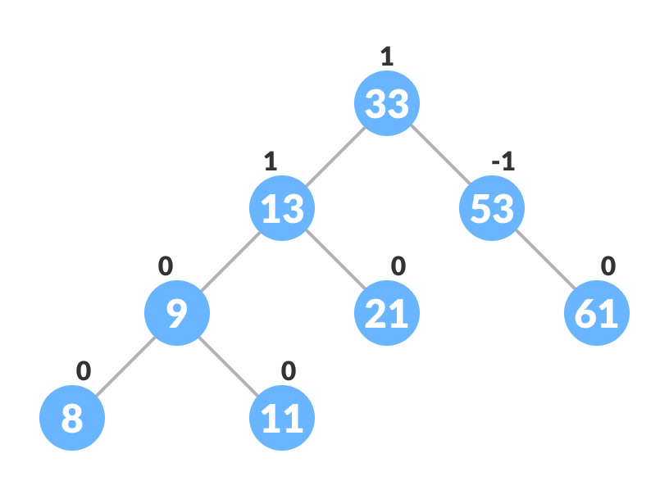
TREE
AVL TREE

Slide 3
Balancing Tree

Slide 4
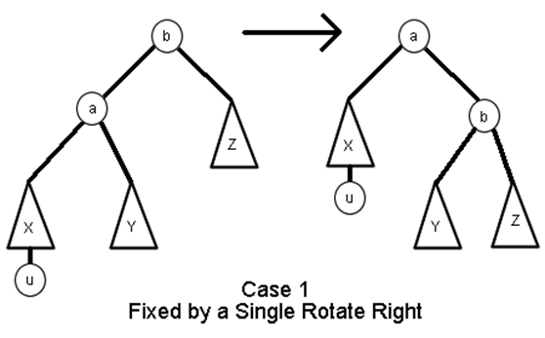
Right-Right Case

Slide 5
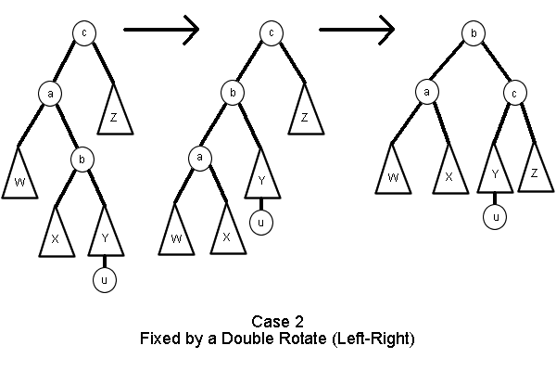
Left-Right Case

Slide 6
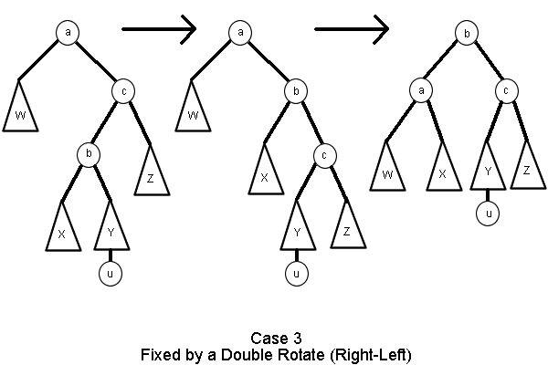
Right-Left Case

Slide 7
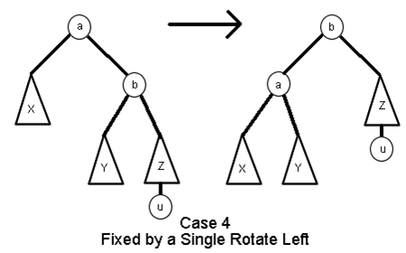
Left-Left Case

Slide 8
Implementasi

Slide 9
Rotation
LEFT
RIGHT
Node *leftRotate(Node *root){
Node *rChild = root->right;
Node *tmp = rChild->left;
rChild->left = root;
root->right = tmp;
rChild->height = max(
height(rChild->left),
height(rChild->right)
) + 1;
root->height = max(
height(root->left), height(root->right)
) + 1;
return rChild;
}
Node *rightRotate(Node *root){
Node *lChild = root->left;
Node *tmp = lChild->right;
lChild->right = root;
root->left = tmp;
lChild->height = max(
height(lChild->left),
height(lChild->right)
) + 1;
root->height = max(
height(root->left), height(root->right)
) + 1;
return lChild;
}

Slide 10
Persiapan praktikum selanjutnya
Pelajari tentang bahasa C++
Baca tentang Red Black Tree

